Slide 1
Sequence to Sequence Learning with Neural Networks
Ilya Sutskever, Oriol Vinyals, Quoc V. Le
Conference: NeurlIPS 2014
Speaker:沈子豪

Slide 2
Outline
Seq2seq 簡介
Introduction
The model
Experiment
Conclusion

Slide 3
Seq2seq 簡介
何謂 Sequence (序列)？
連續性的資料
Ex: 一句話、一段音訊……等等
Seq2seq 顧名思義，就是吃進一段序列後輸出另一段序列
Ex: 音檔轉文字檔、翻譯、文章重點擷取

Slide 4
Seq2seq 簡介
處理序列資料 => 往常會用 RNN 來實作
但 RNN 的 輸入/輸出 架構是固定 (fixed) 的，如：N to N、1 to N、N to 1
所以無法實現 “輸入、輸出長度不同 (不固定)” 的需求
所以 Seq2seq 架構就此誕生
分為 Encoder、Decoder 兩部分 (本論文兩部分皆使用 LSTM)
Encoder 先把輸入轉成一個向量
Decoder 再把向量解碼成輸出序列

Slide 5
Outline
Seq2seq 簡介
Introduction
The model
Experiment
Conclusion

Slide 6
Introduction (1 / 3)
DNNs (Deep Neural Networks) are powerful because they can perform arbitrary parallel computation for a modest number of steps.
Despite their flexibility and power, DNNs can only be applied to problems whose inputs and targets can be sensibly encoded with vectors of fixed dimensionality.

Slide 7
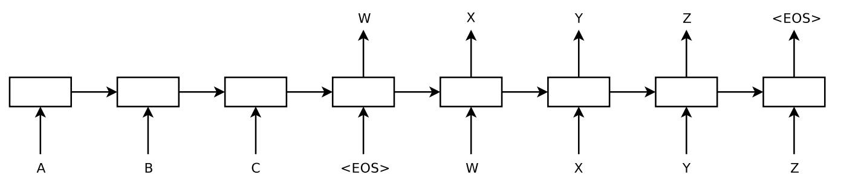
Introduction (2 / 3)
In this paper, we show that a straightforward application of the Long Short-Term Memory (LSTM) architecture can solve general sequence to sequence problems.
One LSTM read the input sequence, one timestep at a time, to obtain large fixed-dimensional vector representation
Another LSTM extract the output sequence from that vector

Slide 8
Introduction (3 / 3)
LSTM did not suffer on very long sentences
Because we reversed the order of words in the source sentence
LSTM learns to map an input sentence of variable length into a fixed-dimensional vector representation
LSTM finds sentence representations that capture their meaning
Sentences with similar meanings are close to each other while different sentences meanings will be far

Slide 9
Outline
Seq2seq 簡介
Introduction
The model
Experiment
Conclusion

Slide 10
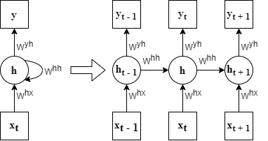
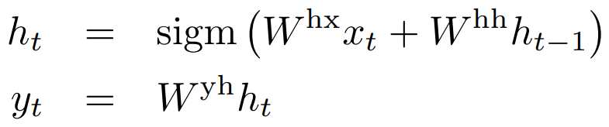
The model (1 / 4)
RNN (Recurrent Neural Network)
A natural generalization of feedforward neural networks to sequences
(x₁, . . . , x_{T} ): Sequence of inputs
(y₁, . . . , y_{T} ): Sequence of outputs
It is not clear how to apply an RNN to problems whose input and the output sequences have different lengths

Slide 11
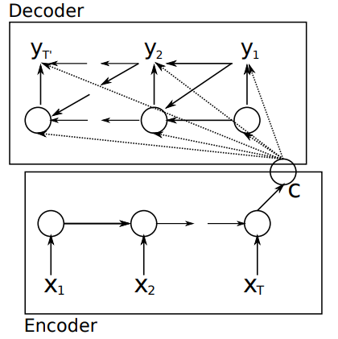
The model (2 / 4)
Cho et al. [5]
Map the input sequence to a fixed-sized vector using one RNN
Map the vector to the target sequence with another RNN

Slide 12
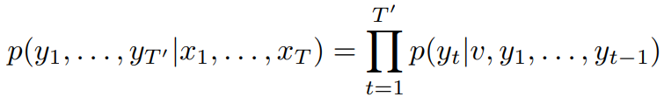
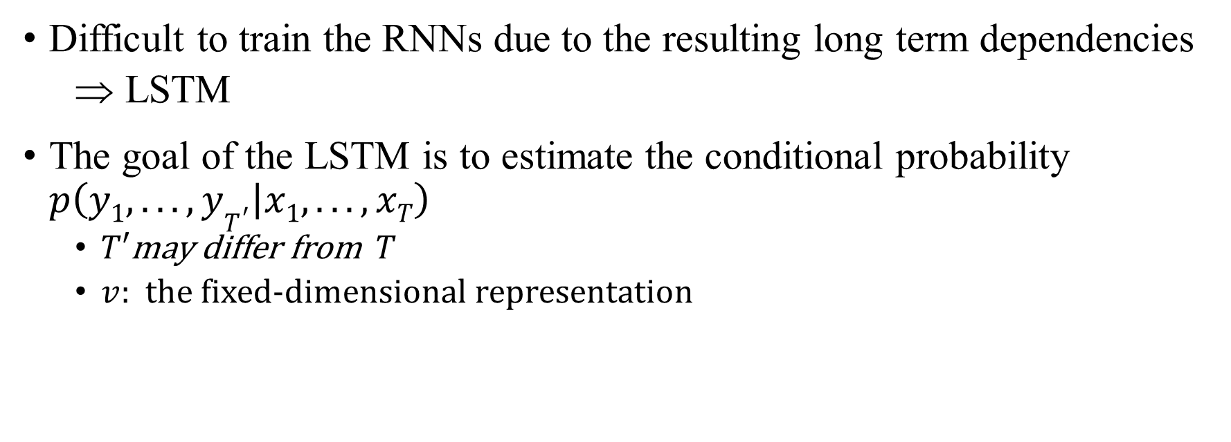
The model (3 / 4)
Difficult to train the RNNs due to the resulting long term dependencies
LSTM
The goal of the LSTM is to estimate the conditional probability $p\left(y1, . . . , yT^{′} | x1, . . . , xT\right)$
$T′$may differ from $T$
$v$: the fixed-dimensional representation

Slide 13
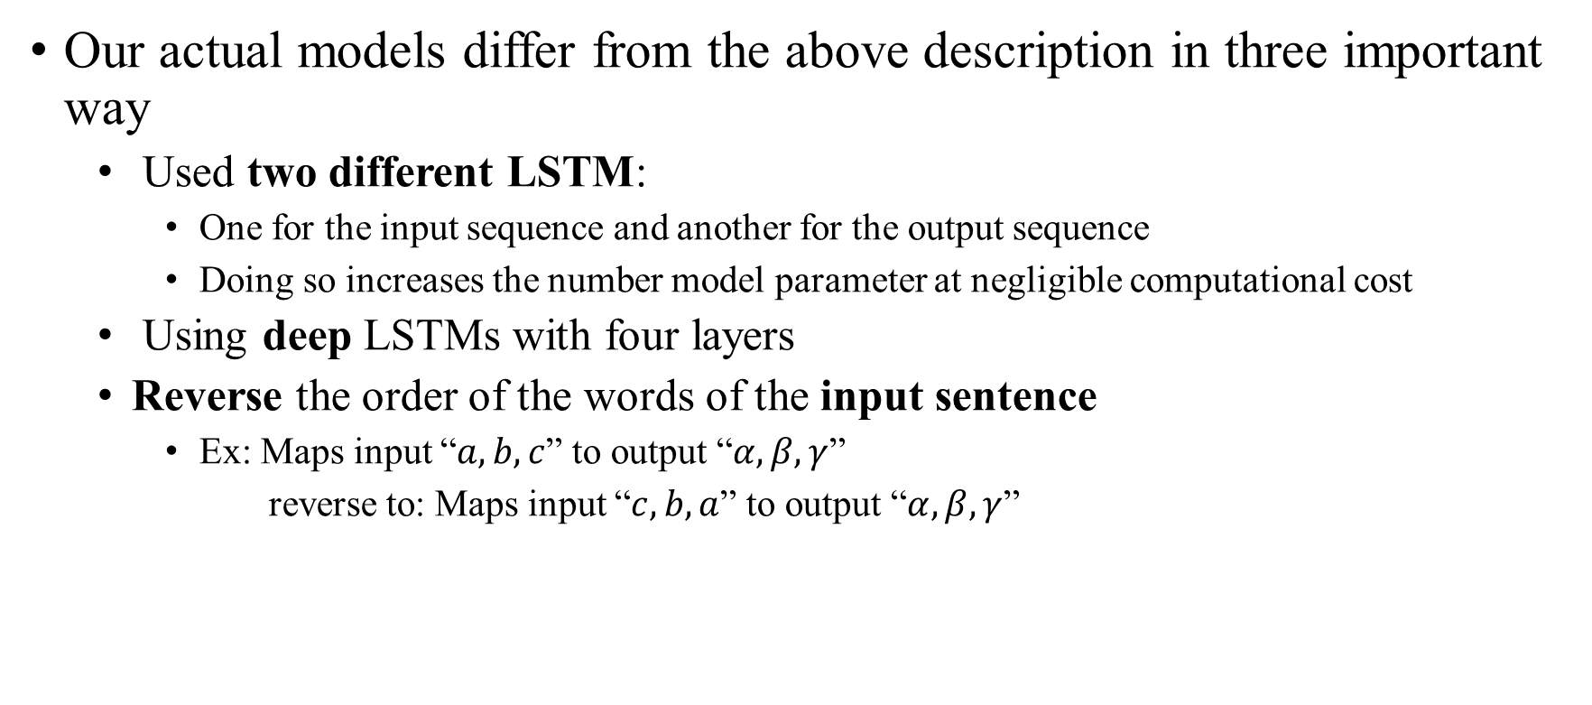
The model (4 / 4)
Our actual models differ from the above description in three important way
Used two different LSTM:
One for the input sequence and another for the output sequence
Doing so increases the number model parameter at negligible computational cost
Using deep LSTMs with four layers
Reverse the order of the words of the input sentence
Ex: Maps input “$a, b, c$” to output “$α, β, γ$”
reverse to: Maps input “$c, b, a$” to output “$α, β, γ$”

Slide 14
Outline
Seq2seq 簡介
Introduction
The model
Experiment
Conclusion

Slide 15
Experiments - Dataset details
Dataset: WMT’14 English to French
12M sentences
348M French words
304M English words
Neural language models rely on a vector representation for each word:
160,000 of the most frequent words for the source language
80,000 of the most frequent words for the target language
Out-of-vocabulary word was replaced with a special “UNK” token

Slide 16
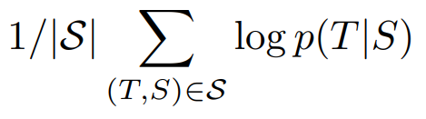

Experiments - Decoding and Rescoring (1 / 3)
The core of our experiments involved training a large deep LSTM on many sentence pairs
Maximizing the log probability of a correct translation T given the source sentence S
Once training is complete, we produce translations by finding the most likely translation according to the LSTM

Slide 17
Experiments - Decoding and Rescoring (2 / 3)
We search for the most likely translation using a simple left-to-right beam search decoder

Slide 18
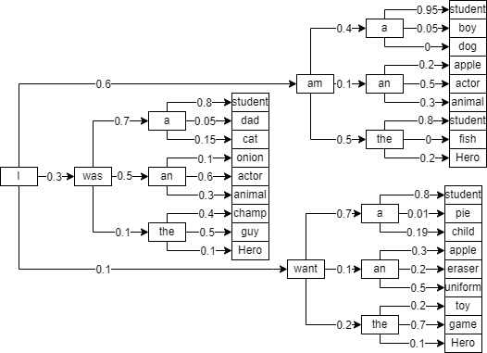
補充 - Beam Search (1 / 3)
假設我們希望機器生成句子 “I am a student” (目前已讓機器知道句首為 “I”)

Slide 19
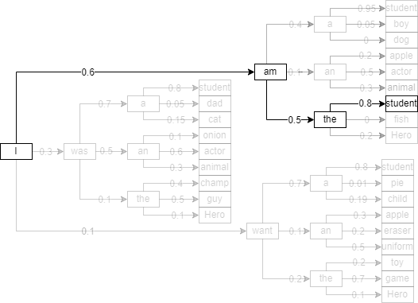
補充 - Beam Search (2 / 3)
Greedy 結果輸出: “I am the student”
因為 “the” 的權重比 “a” 高

Slide 20
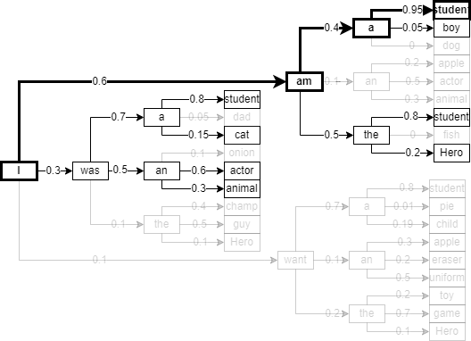
補充 - Beam Search (3 / 3)
以 Beam Search，假設 k = 2
取 “總分最高的路徑”
成功得到 “I am a student”

Slide 21
Experiments - Decoding and Rescoring (3 / 3)
We search for the most likely translation using a simple left-to-right beam search decoder
At each timestep we extend each partial hypothesis in the beam with every possible word in the vocabulary
Discard all but the B most likely hypotheses according to the model’s log probability
As soon as the “<EOS>” symbol is appended to a hypothesis, it is removed from the beam and is added to the set of complete hypotheses

Slide 22
Experiments - Reversing the Source Sentences
LSTM learns much better when the source sentences are reversed
We believe that it is caused by the introduction of many short term dependencies to the dataset
“Minimal time lag”
The first few words in the source language are now very close to the first few words in the target language, so the problem’s minimal time lag is greatly reduced

Slide 23
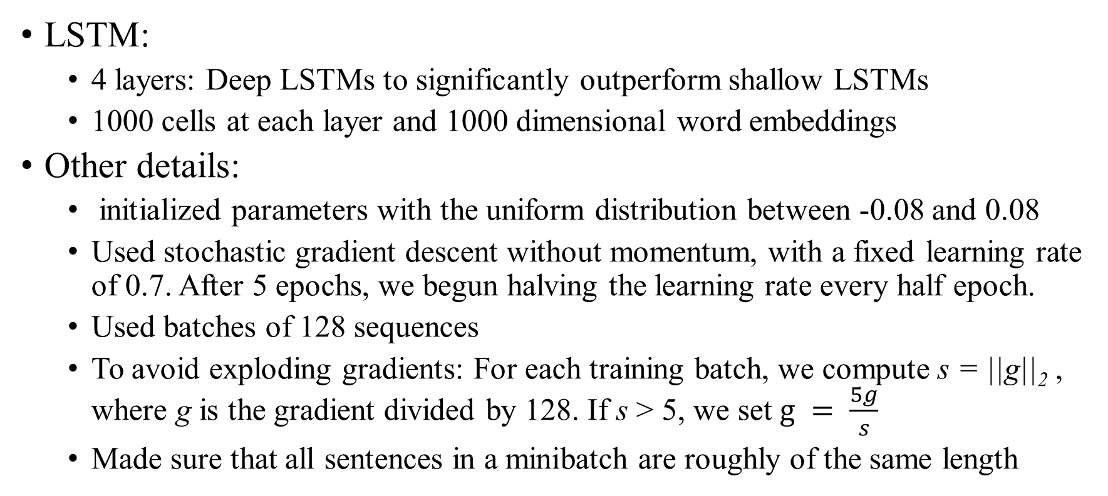
Experiments - Training details
LSTM:
4 layers: Deep LSTMs to significantly outperform shallow LSTMs
1000 cells at each layer and 1000 dimensional word embeddings
Other details:
initialized parameters with the uniform distribution between -0.08 and 0.08
Used stochastic gradient descent without momentum, with a fixed learning rate of 0.7. After 5 epochs, we begun halving the learning rate every half epoch.
Used batches of 128 sequences
To avoid exploding gradients: For each training batch, we compute s = ||g||₂ , where g is the gradient divided by 128. If s > 5, we set $g = \frac{5g}{s}$
Made sure that all sentences in a minibatch are roughly of the same length

Slide 24
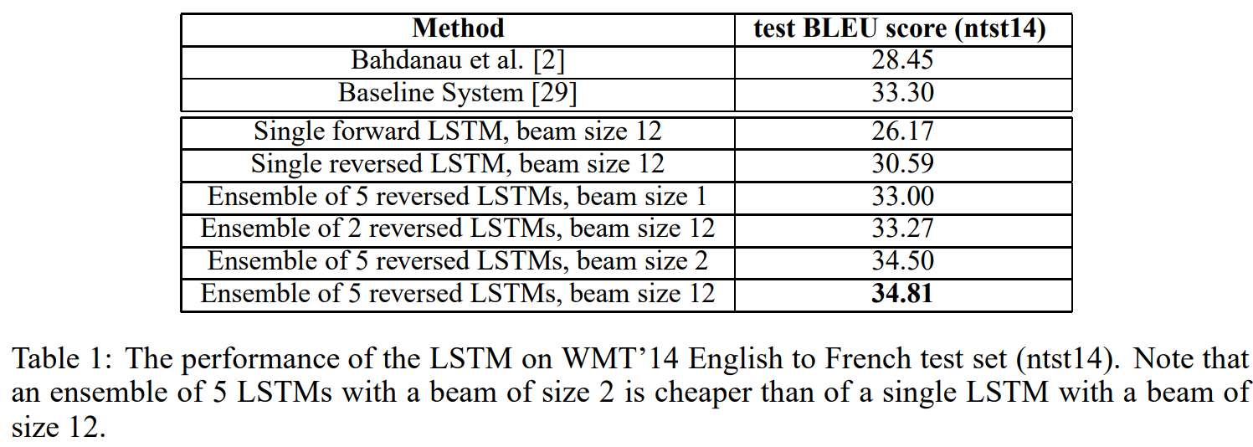
Experiments - Experimental Results (1 / 2)
Evaluate: BLEU score

Slide 25
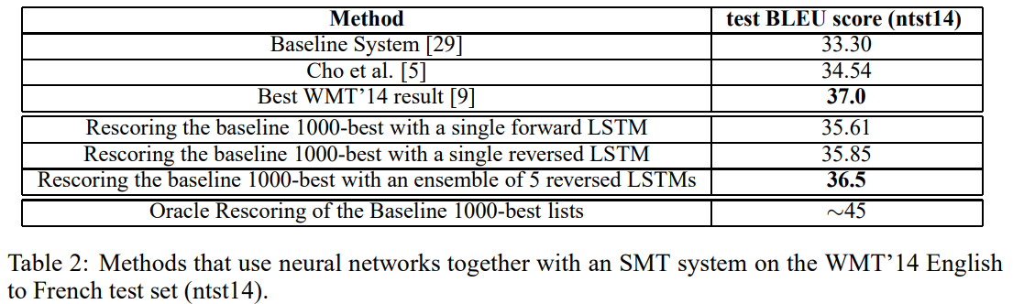
Experiments - Experimental Results (2 / 2)
It is the first time that a pure neural translation system outperforms a phrase-based SMT baseline on a large scale MT task by a sizeable margin

Slide 26
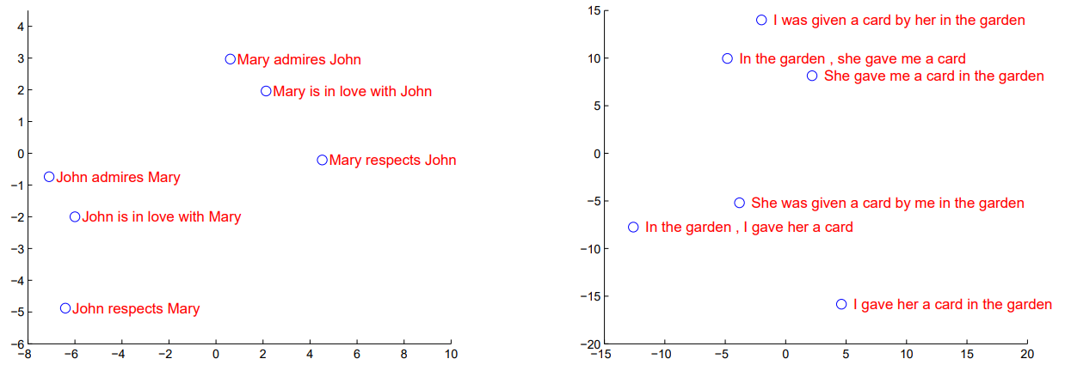
Experiments - Model Analysis (1 / 2)
Our model is its ability to turn a sequence of words into a vector of fixed dimensionality

Slide 27
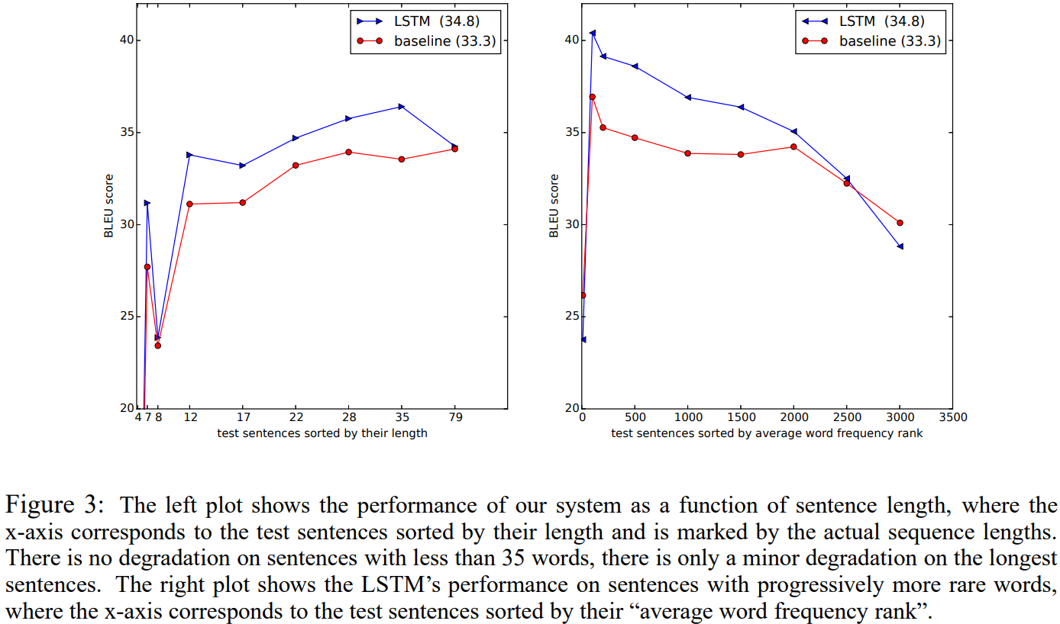
Experiments - Model Analysis (2 / 2)
We were surprised that the LSTM did well on long sentences

Slide 28
Outline
Seq2seq 簡介
Introduction
The model
Experiment
Conclusion

Slide 29
Conclusion
We were surprised by the extent of the improvement obtained by reversing the words in the source sentences
We were also surprised by the ability of the LSTM to correctly translate very long sentences
We demonstrated that a simple, straightforward and a relatively unoptimized approach can outperform an SMT system

